Slide 1
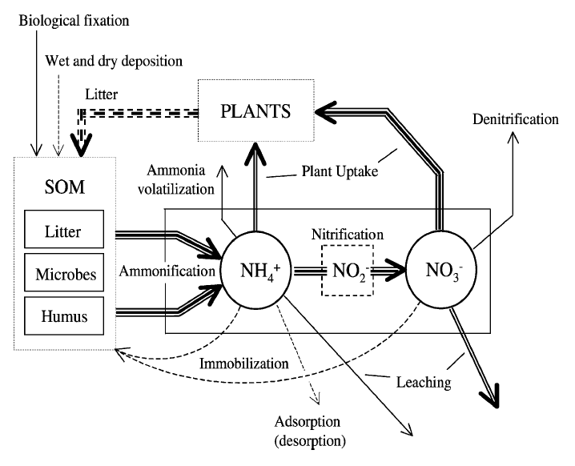
Candidate model for nutrient reachability analysis
Source: climate.gov
Porporato et al., 2004
9 states:
S – soil moisture
C_{l} – carbon, litter
C_{h} – carbon, humus
C_{b} – carbon, biomass
N_{l} – nitrogen, litter
N_{h} – nitrogen, humus
N_{b} – nitrogen, biomass
N⁺ – nitrogen, ammonium
N⁻ – nitrogen, nitrate
stochastic
Available to plants but susceptible to losses
01/25/2023
Notes:
Why nitrogen and why this model?
Nitrogen gets slightly more attention. This model is well-known and widely used. Similar models for C-P cycling are not quite as well known. Multiple applications of N are more common than P because N is more mobile – this will matter for the questions asked at the end of this study. If ever want to test out result on more detailed model, more is available for N than P.

Slide 2
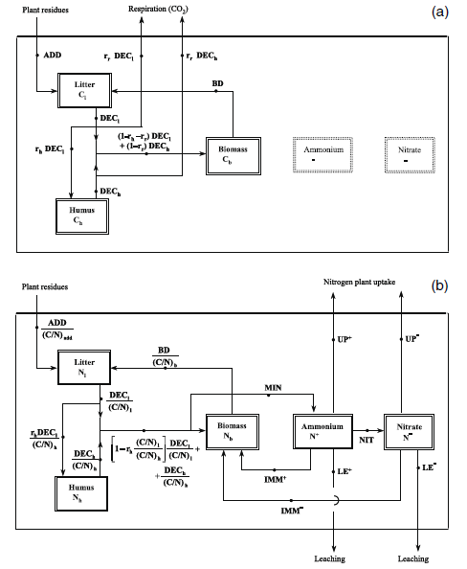
Candidate model for nutrient reachability analysis
Source: climate.gov
Porporato et al., 2004
9 states:
S – soil moisture
C_{l} – carbon, litter
C_{h} – carbon, humus
C_{b} – carbon, biomass
N_{l} – nitrogen, litter
N_{h} – nitrogen, humus
N_{b} – nitrogen, biomass
N⁺ – nitrogen, ammonium
N⁻ – nitrogen, nitrate
stochastic
Available to plants but susceptible to losses
01/25/2023

Slide 3
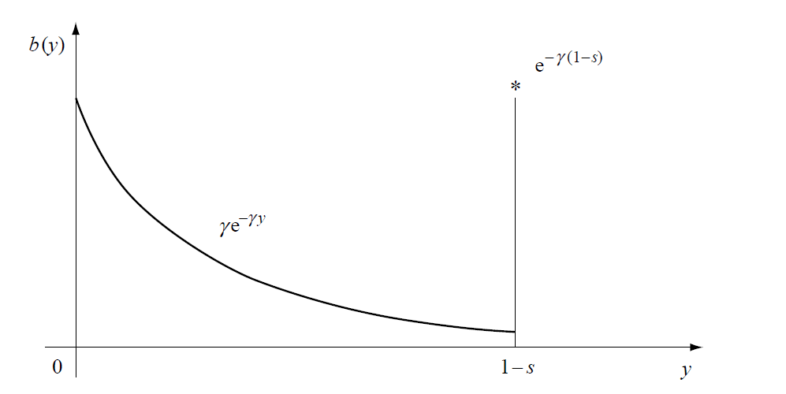
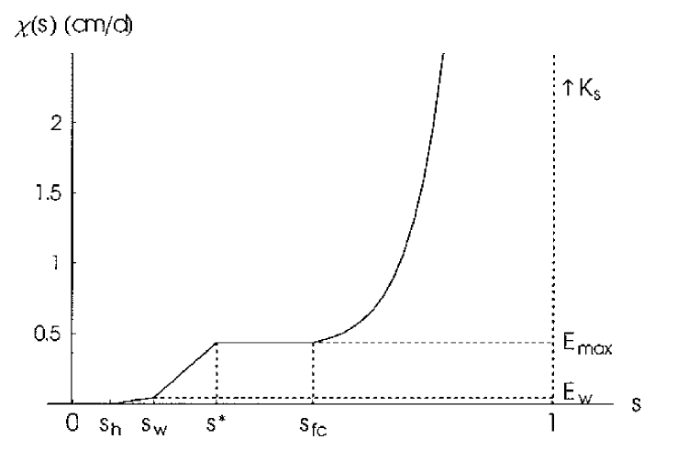
Candidate model for nutrient reachability analysis
Source: climate.gov
Porporato et al., 2004
Soil moisture dynamics:
RAINFALL
Occurrence as Poisson process
Depth as exponential distribution
LOSSES
Evaporation, transpiration, and leakage
01/25/2023

Slide 4
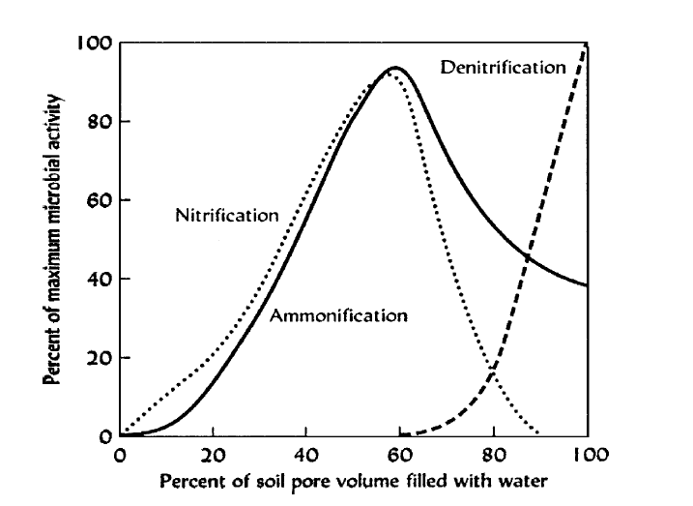
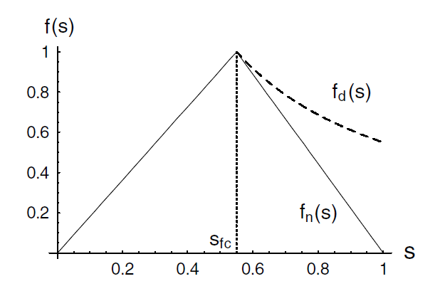
Candidate model for nutrient reachability analysis
Source: climate.gov
Porporato et al., 2004
Carbon and nitrogen dynamics are mediated by soil moisture (and temperature, if we want that complexity):
Reality
Model
01/25/2023

Slide 5
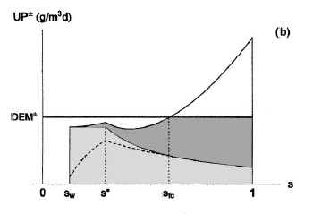
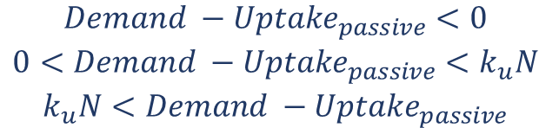


Candidate model for nutrient reachability analysis
Source: climate.gov
Porporato et al., 2004
Management goals would be to minimize N leaching and avoid N deficit (uptake less than plant demand):
$$Leaching=a \frac{water leakage}{volume water per unit area}N$$
minimize
$${Uptake}_{active}=\left\{\begin{aligned}0 \\ Demand −{Uptake}_{passive} \\ k_{u}N\end{aligned}\right.$$
$$\begin{matrix}Demand −{Uptake}_{passive}<0 \\ 0<Demand −{Uptake}_{passive}<k_{u}N \\ k_{u}N<Demand −{Uptake}_{passive}\end{matrix}$$
avoid
01/25/2023
Notes:
Let plant demand be external, but potentially varying throughout growing season.

Slide 6
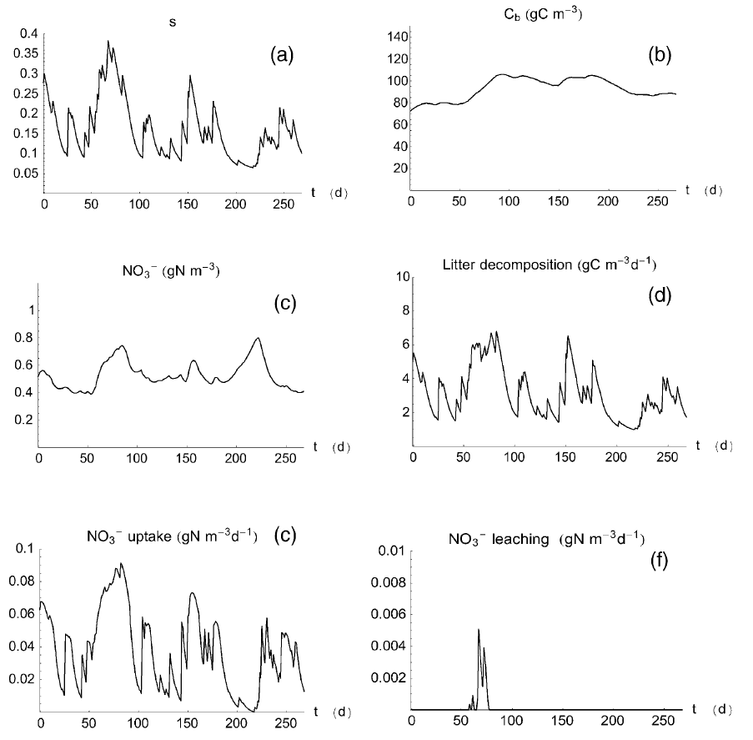
Source: climate.gov
Porporato et al., 2004
Model outputs (example):
01/25/2023

Slide 7
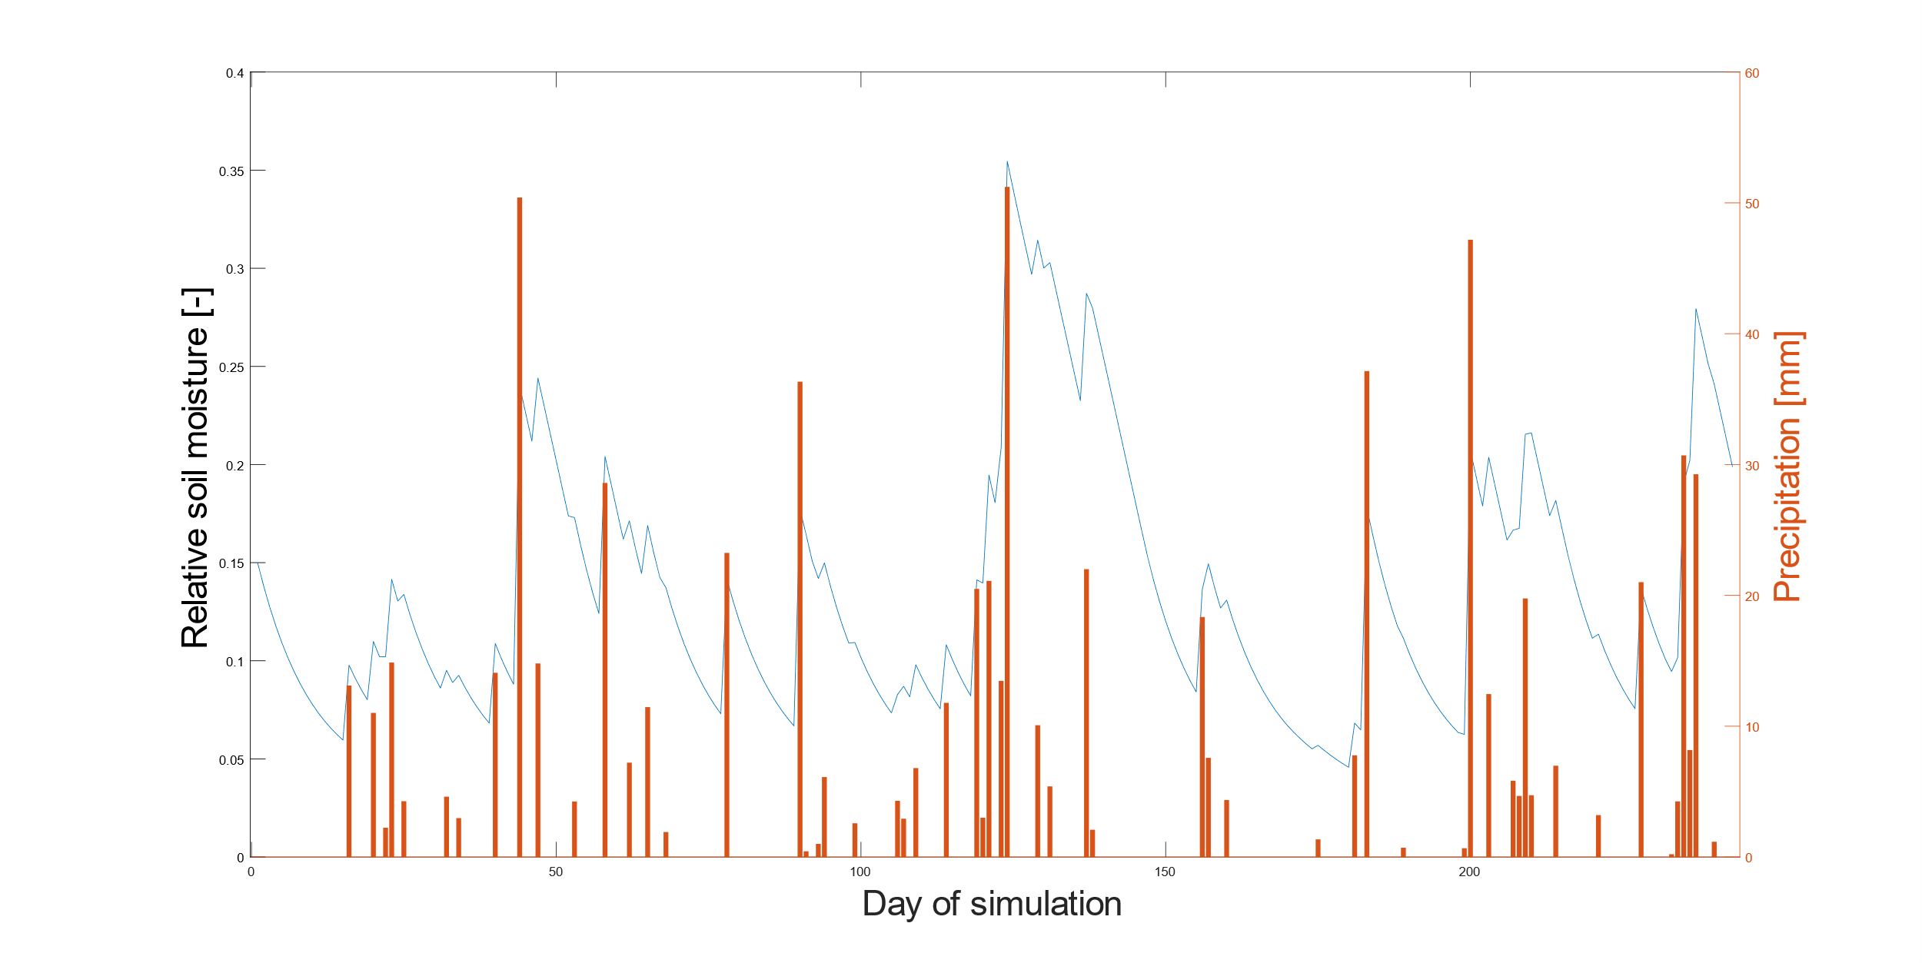
Soil moisture and nitrogen dynamics (1): random precipitation drives soil moisture dynamics, which in turn mediate carbon and nitrogen dynamics

Slide 8
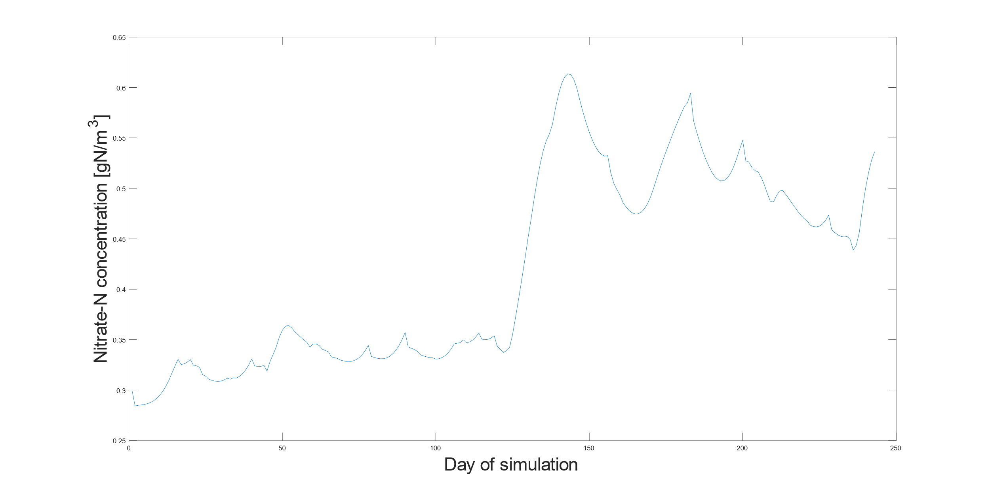
Soil moisture and nitrogen dynamics (2): random precipitation drives soil moisture dynamics, which in turn mediate carbon and nitrogen dynamics

Slide 9
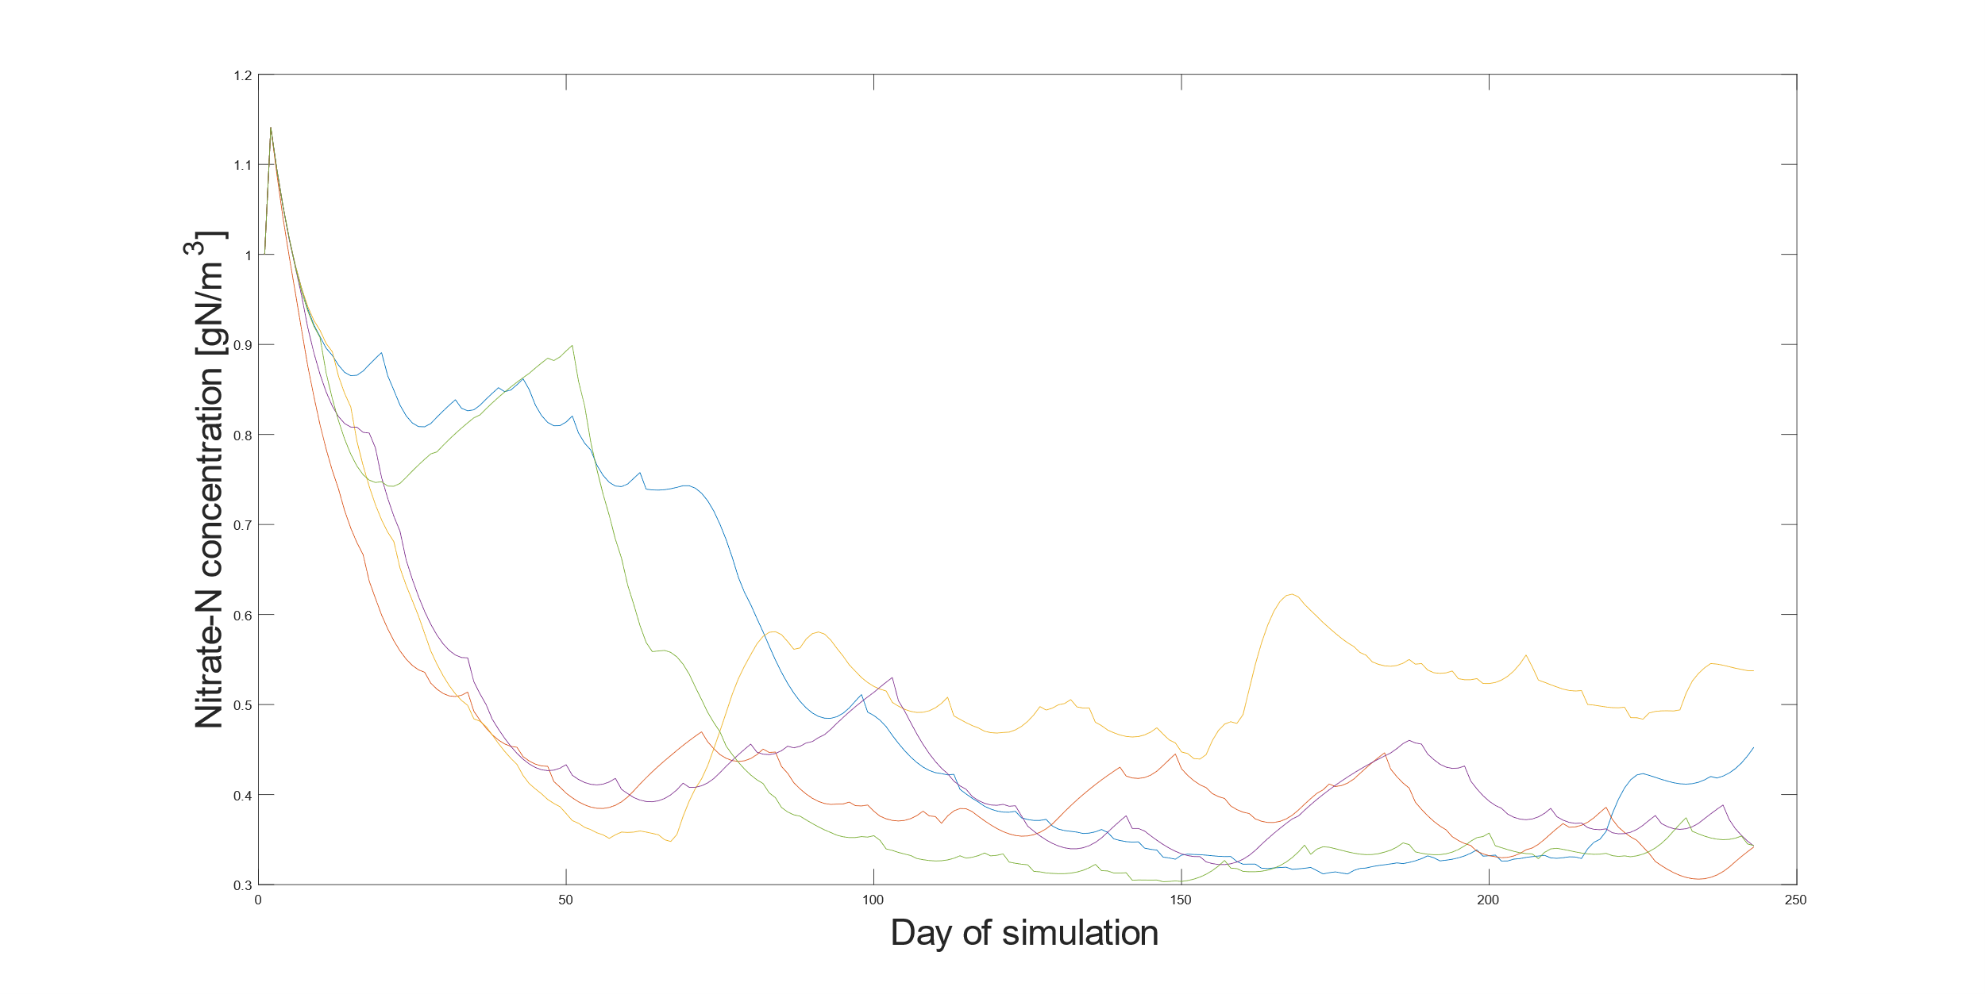
Nitrogen dynamics from 5 simulations. All beginning with same (high) initial nitrate concentration, but different precipitation realizations. If, for instance, 0.4 g N/m³ were a critical concentration threshold for crop growth, each precipitation realization would incur failure here.

Slide 10
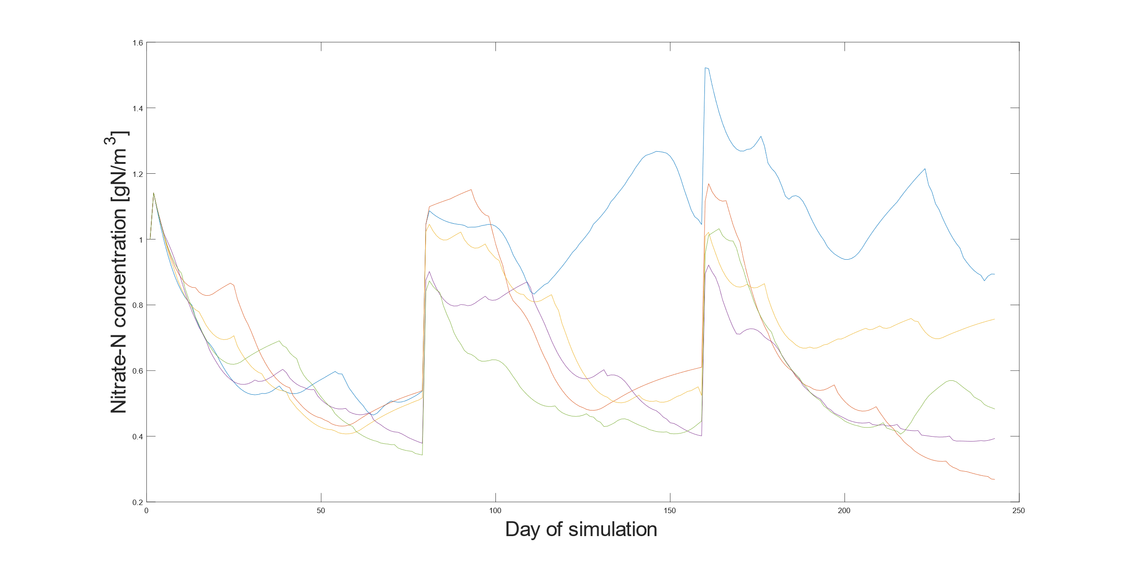
Nitrogen dynamics from 5 simulations – with fertilization on days 80 and 160. Now some precipitation realizations cause failure (fall below 0.4 g N/m³) but not all.

